Slide 1

Unit Testing
Building Rock-Solid Software
SoftUni Team
Technical Trainers
Software University
https://softuni.bg

Slide 2
Table of Contents
What is Unit Testing?
Unit Testing Basics
3A Pattern
Good Practices
Unit Testing Frameworks – NUnit
Mocking and Mock Objects

Slide 3
Questions
sli.do #csharp-advanced

Slide 4

Seven Testing Principles

Slide 5
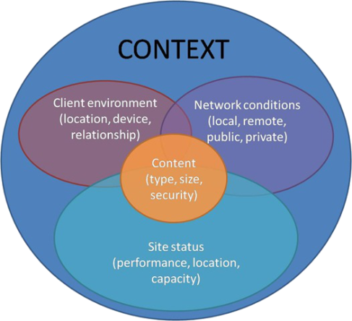
Seven Testing Principles
Testing is context dependent
Testing is done differently in different contexts
Example:
Safety-critical software is tested differently from an e-commerce site

Slide 6
Seven Testing Principles (2)
Exhaustive testing is impossible
All combinations of inputs and preconditions are usually almost infinite number
Testing everything is not feasible
Except for trivial cases
Risk analysis and priorities should be used to focus testing efforts

Slide 7
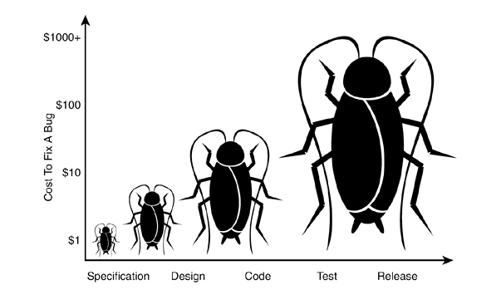
Seven Testing Principles (3)
Early testing is always preferred
Testing activities shall be started as early as possible
And shall be focused on defined objectives
The later a bug is found – the more it costs!

Slide 8
Seven Testing Principles (4)
Defect clustering
Testing effort shall be focused proportionally
To the expected and later observed defect density of modules
A small number of modules usually contains most of the defects discovered
Responsible for most of the operational failures
Notes:
In your opinion which operation is most likely to cause your Operation system to fail?
- Opening Microsoft Word
- Open IE
- Opening 10 different application all at the same time

Slide 9
Seven Testing Principles (5)
Pesticide paradox
Same tests repeated over and over again tend to lose their effectiveness
Previously undetected defects remain undiscovered
New and modified test cases should be developed

Slide 10
Seven Testing Principles (6)
Testing shows presence of defects
Testing can show that defects are present
Cannot prove that there are no defects
Appropriate testing reduces the probability for defects

Slide 11
Seven Testing Principles (7)
Absence-of-errors fallacy
Finding and fixing defects itself does not help in these cases:
The system built is unusable
Does not fulfill the users’ needs and expectations

Slide 12

Software Used to Test Software
What is Unit Testing

Slide 13
Manual Testing
Not structured
Not repeatable
Can’t cover all of the code
Not as easy as it should be
void TestSum()
{
if (this.Sum(1, 2) != 3)
throw new Exception("1 + 2 != 3");
}

Slide 14
Moving Away from Manual Testing
We need a structured approach that:
Allows refactoring
Reduces the cost of change
Decreases the number of defects in the code
Bonus:
Improves design

Slide 15
Automated Testing
More types of testing: Regression, UI, Load, Performance, Stress, Security, Manual, Acceptance, Black-box, A/B, etc.
System tests
Integration tests
Unit tests
System
Integration
Unit

Slide 16
Integration Tests

Slide 17

Setup and First Test
NUnit 3.0

Slide 18
NUnit
Initially ported from Junit
NUnit version 3.0, has been completely rewritten
NUnit is an Open Source software
Support for a wide range of .NET platforms

Slide 19
Nunit vs MSTest
NUnit allows for parameterized tests
Readable Assert method
NUnit has frequent version updates MS-Test has only one per VS version
Expected exception message assertion
Can be done using attribute in NUnit
Must be done using Try-Catch in MS-Test

Slide 20
Problem: NUnit Test
Create console application project
Add BankAccount class
Create NUnit Project
Test the BankAccount class

Slide 21
Solution: NUnit Test(2)
Create a class library (.Net Core)
Name it like the project you are testing, but with ".Tests" suffix
Right click on the project to open the NuGet package manager
Create a console applicaton
Add BankAccount class for us to test
BankAccount
+Amount : decimal
+BankAccount(decimal)

Slide 22
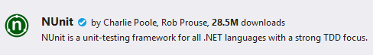
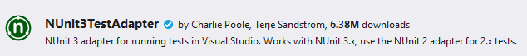
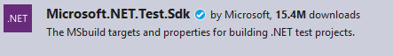
Solution: NUnit Test(2)
Install NUnit
Install NUnit3TestAdapter
Install Microsoft.Net.Test.Sdk
Open Test Explorer (Ctrl + E, T or Test->Windows ->TestExplorer)

Slide 23
Solution: NUnit Test (3)
Write your first test
Attribute that marks a class that contains tests
[TestFixture]
public class BankAcountTests
{
[Test]
public void AccountInitializeWithPositiveValue() {
BankAccount account = new BankAccount(2000m);
Assert.That(account.Amount, Is.EqualTo(2000m));
}
}
Test Method
Assert class comes with NUnit

Slide 24
What is AAA Testing Pattern
Organize and clarify test code by breaking down a test case into the following functional sections:
The Arrange section of a unit test initializes objects and sets the value of the data that is passed to the test case
The Act section invokes the test case with the arranged parameters
The Assert section verifies the test case behaves as expected

Slide 25
3A Pattern
[Test]
public void DepositShouldAddMoney()
{
BankAccount account = new BankAccount();
account.Deposit(50);
Assert.That(account.Balance, Is.EqualTo(50));
}
Each test should test a single behavior!

Slide 26
Problem: Test Axe
Load provided solution in Visual Studio
Add new test project Tests
Create a class AxeTests
Create the following tests:
Test if weapon loses durability after attack
Test attacking with a broken weapon

Slide 27
Solution: Test Axe
[Test]
public void AxeLosesDurabilyAfterAttack()
{
// Arrange
Axe axe = new Axe(10, 10);
Dummy dummy = new Dummy(10, 10);
// Act
axe.Attack(dummy);
// Assert
Assert.That(axe.DurabilityPoints, Is.EqualTo(9));
}

Slide 28
Solution: Test Axe (2)
[Test]
public void BrokenAxeCantAttack()
{
Axe axe = new Axe(1, 1);
Dummy dummy = new Dummy(10, 10);
axe.Attack(dummy);
Assert.That(() => axe.Attack(dummy),
Throws.InvalidOperationException
.With.Message.EqualTo("Axe is broken."));
}

Slide 29
Problem: Test Dummy
Create a class DummyTests
Create the following tests
Dummy loses health if attacked
Dead Dummy throws exception if attacked
Dead Dummy can give XP
Alive Dummy can't give XP

Slide 30
Solution: Test Dummy
[Test]
public void DummyLosesHealthAfterAttack()
{
// Arrange
Dummy dummy = new Dummy(20, 10);
// Act
dummy.TakeAttack(5);
// Assert
Assert.That(dummy.Health, Is.EqualTo(15));
}
// TODO: Write the rest of the tests

Slide 31

How to Write Good Tests
Unit Testing Best Practices

Slide 32
Asserts
Condition
Comparison
Exception
Assert.That(bool condition);
Assert.That(actual, Is.EqualTo(expected));
Assert.That(() => { code },
Throws.ExpectedException);

Slide 33
Asserts (2)
String Assert
Collection Assert
File Assert
Assert.That(string actual,
Does.Contain(string expected));
Assert.That(IEnumerable expected Has.Member(object actual));
Assert.That(string filePath, Does.Exist);
Assert.That(FileInfo file, Does.Exist);

Slide 34
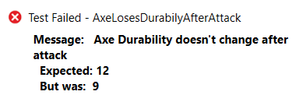
Assertion Messages
Assertions can show messages
Helps with diagnostics
Assert.That(axe.DurabilityPoints, Is.EqualTo(12),
"Axe Durability doesn't change after attack");
Test failure messages help to find the problem

Slide 35
Don't Repeat Yourself
private BankAccount account;
[SetUp]
public void TestInit()
{
this.account = new BankAccount();
}
[TearDown]
public void TestCleanUp() { … }
Executes before each test
Executes after each test

Slide 36


Naming Test Methods
Test names
Should use business domain terminology
Should be descriptive and readable
IncrementNumber() {}
Test1() {}
TestTransfer() {}
DepositAddsMoneyToBalance() {}
DepositNegativeShouldNotAddMoney() {}
TransferSubtractsFromSourceAddsToDestAccount() {}

Slide 37
Problem: Refactor Tests
Refactor the tests for Axe and Dummy classes
Make sure that:
Names of test methods are descriptive
You use appropriate assertions (assert equals vs assert true)
You use assertion messages
There are no magic numbers
There is no code duplication (Don’t Repeat Yourself)

Slide 38
Solution: Refactor Tests
private Axe axe;
private Dummy dummy;
[SetUp]
public void TestInit()
{
this.axe = new Axe(2, 2);
this.dummy = new Dummy(20, 20);
}

Slide 39
Solution: Refactor Tests (2)
[Test]
public void AxeLosesDurabilyAfterAttack()
{
axe.Attack(dummy);
Assert.That(axe.DurabilityPoints, Is.EqualTo(1)
"Axe Durability doesn't change after attack");
}
[Test]
public void BrokenAxeCantAttack()
{ axe.Attack(dummy);
axe.Attack(dummy);
Assert.That(() => axe.Attack(dummy),
Throws.InvalidOperationException.With.Message
.EqualTo("Axe is broken.")); }

Slide 40

Isolating Behaviors
Dependencies

Slide 41
Coupling and Testing
Consider testing the following code:
We want to test a single behavior
Concrete Implementation
public class Bank {
private AccountManager accountManager;
public Bank()
{
this.AccountManager = new AccountManager();
}
public AccountInfo GetInfo(string id) { … }
}
Bank depends on AccountManager

Slide 42
Coupling and Testing (2)
Need to find solution to decouple classes
Interface
Bank inherits bugs
IAccountManager
+Account GetAccount()
Bank
AccountManager
uses
Bank

Slide 43
Dependency Injection
Decouples classes and makes code testable
public interface IAccountManager
{
Account Account { get; }
}
public class Bank
{
private IAccountManager accountManager;
public Bank(IAccountManager accountManager)
{
this.accountManager = accountManager;
}
}
Independent from Implementation
Injecting dependencies

Slide 44
Goal: Isolating Test Behavior
In other words, to fixate all moving parts
[Test]
public void TestGetInfoById()
{
AccountManager manager = new AccountManager()
{
public Account Account(String id) { … }
}
Bank bank = new Bank(manager);
AccountInfo info = bank.GetInfo(id);
// TODO: Assert…
}
Anonymous class
Fake interface implementation with fixed behavior

Slide 45
Problem: Fake Axe and Dummy
Test if hero gains XP when target dies
You need to:
Make Hero class testable (use Dependency Injection)
Introduce Interfaces for Axe and Dummy
Interface IWeapon
Interface ITarget
Create test using a fake Weapon and fake Dummy

Slide 46
Solution: Fake Axe and Dummy
public interface IWeapon
{
void Attack(Target target);
int AttackPoints { get; }
int DurabilityPoints { get; }
}
public interface Itarget
{
void TakeAttack(int attackPoints);
int Health { get; }
int GiveExperience();
bool IsDead();
}

Slide 47
Solution: Fake Axe and Dummy (2)
public Hero(String name, IWeapon weapon)
{
this.name = name;
this.experience = 0;
this.weapon = weapon;
}
Dependency Injection through the constructor
public class Axe : IWeapon
{
public void attack(ITarget target) { … }
}

Slide 48
Solution: Fake Axe and Dummy (3)
public class FakeTarget : ITarget
{
public void TakeAttack(int attackPoints) { … }
public int Health => 0;
public int GiveExperience() { return 20; }
public bool IsDead() { return true; }
}
// TODO: Implement FakeWeapon

Slide 49
Solution: Fake Axe and Dummy (4)
private const string HeroName = "Pesho";
[Test]
public void HeroGainsExperienceAfterAttackIfTargetDies()
{
ITarget fakeTarget = new FakeTarget();
IWeapon fakeWeapon = new FakeWeapon();
Hero hero = new Hero(HeroName, fakeWeapon);
hero.attack(fakeTarget);
// Assert…
}

Slide 50
Fake Implementations
Not readable, cumbersome and has too much boilerplate
[Test]
public void TestRequiresFakeImplementationOfBigInterface() {
// Arrange
Database db = new BankDatabase()
{
// Too many methods…
}
AccountManager manager = new AccountManager(db);
// Act…
// Assert…
}
Not suitable for big interfaces

Slide 51
Mocking
Mock objects simulate behavior of real objects
The object supplies non-deterministic results - Time
It has states that are difficult to create or reproduce - Network
It is slow - Database
It does not yet exist or may change behavior
It would have to include information and methods exclusively for testing purposes (and not for its actual task)

Slide 52
Moq Library
Moq provides us with an easy way of creating mock objects
Simple to use
Strongly typed
Minimalistic
Mock<IContainer> mockContainer = new Mock<IContainer>();
Mock<ICustomerView> mockView = new Mock<ICustomerView>();
Notes:
Moq
Moq (pronounced "Mock You") is an open-source mocking framework
Facilitates the mocking process by providing an API for creating fake objects (mocks)
No need to create fake classes for every possible test scenario
Can mock almost any type, not just interfaces
E.g. Random, DateTime, etc.

Slide 53
Mocking Example
Mock<ITarget> fakeTarget = new Mock<ITarget>();
fakeTarget
.Setup(p => p.TakeAttack(It.IsAny<int>()))
.Callback(() => hero.Weapon.DurabilityPoints -= 1);
fakeTarget
.Setup(p => p.Health)
.Returns(0);

Slide 54
Problem: Mocking
Include Moq in the project
Mock fakes from previous problem
Test if hero gains XP when target dies

Slide 55
Solution: Mocking
[Test]
public void HeroGainsExperienceAfterAttackIfTargetDies() {
Mock<ITarget> fakeTarget = new Mock<ITarget>();
fakeTarget.Setup(p => p.Health).Returns(0);
fakeTarget.Setup(p => p.GiveExperience()).Returns(20);
fakeTarget.Setup(p => p.IsDead()).Returns(true);
Mock<IWeapon> fakeWeapon = new Mock<IWeapon>();
Hero hero = new Hero("Pesho", fakeWeapon.Object);
hero.Attack(fakeTarget.Object);
Assert.That(hero.Experience, Is.EqualTo(20));
}

Slide 56

Summary
…
…
…
Unit Testing helps us build solid code
Structure your unit tests – 3A Pattern
Use different assertions depending on the situation
Dependency Injection:
Makes your classes testable
Looses coupling and improves design
Mock objects to isolate tested behaviour

Slide 57
Questions?
Notes:
57

Slide 58












SoftUni Diamond Partners

Slide 59



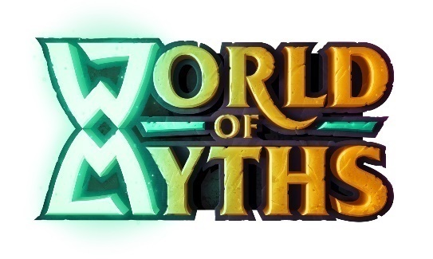
SoftUni Organizational Partners

Slide 60
Trainings @ Software University (SoftUni)
Software University – High-Quality Education, Profession and Job for Software Developers
softuni.bg, softuni.org
Software University Foundation
softuni.foundation
Software University @ Facebook
facebook.com/SoftwareUniversity
Software University Forums
forum.softuni.bg
Notes:
60

Slide 61

License
This course (slides, examples, demos, exercises, homework, documents, videos and other assets) is copyrighted content
Unauthorized copy, reproduction or use is illegal
© SoftUni – https://softuni.org
© Software University – https://softuni.bg
Notes:
61

